Slide 1


Green Pace
Security Policy Presentation
Developer: Concepción Ardon
https://youtu.be/_qpjzAKd-zY

Slide 2

OVERVIEW: DEFENSE IN DEPTH
Defense in Depth (DiD) is a cybersecurity method that layers a succession of defensive procedures to protect critical data and information. If one mechanism fails, another immediately steps in to prevent an attack. This multi-layered strategy with intended redundancy improves overall system security and handles a wide range of attack vectors. The model below shows it’s multi-layered approach.

Slide 3
THREATS MATRIX
Likely Attacks of high severity are likely | Priority Priorities with a high number have higher severity levels.
Low priority Repairing is costly, yet there is little exploitable vulnerability. | Unlikely Attacks will be of low severity.
The greatest priority threats should be prioritized in the appropriate sequence.

Slide 4
10 PRINCIPLES
Validate Input Data
Heed Compiler Warnings
Architect and Design for Security Policies
Keep It Simple
Default Deny
Adhere to the Principles of Least Privilege
Sanitize Data Sent to Other Systems
Practice Defense in Depth
Use Effective Quality Assurance Techniques
Adopt a Secure Coding Standard

Slide 5
CODING STANDARDS
Ensure that operations on signed integers do not result in overflow.
Ensure that unsigned integer operations do not wrap
Do not attempt to modify string literals
Sanitize data passed to complex subsystems
Do not access freed memory
Incorporate diagnostic tests using assertions
Guarantee exception safety
Do not use pointer-to-member operators to access nonexistent members
Functions should validate their parameters
Do not access an object outside of its lifetime

Slide 6
ENCRYPTION POLICIES
Encryption in rest - By guaranteeing that the data is encrypted when it is on disk, encryption in rest is intended to stop the attacker from obtaining the unencrypted data. You are essentially transforming your customers' sensitive data into another type of data when you encrypt data while it is at rest. This often occurs using an algorithm that a user without access to the encryption key to decode it cannot comprehend. Your data will remain secure because these files will only be accessible by authorized employees.
Encryption at flight - The encryption of data in flight refers to data transmission through a network. This is crucial for people that use the open internet to transport data, which is a component of the majority of public cloud systems. The underlying FASP protocol employs the Cipher Feedback with Checksum technique to guarantee the security and integrity of data in flight each time you send content using an Aspera web app.
Encryption in use - Data is deemed to be in use when it is currently accessible and utilised. Data security must be taken care of before actual data use can start since data must be decrypted in order to be put to use. Secure Encrypted Virtualization is a technique for data encryption in use (SEV). It uses specialized hardware, an AMD EPYC processor, and an AES-128 encryption engine to encrypt RAM memory. Although this field is still relatively young, other hardware suppliers are also providing memory encryption for data in use.

Slide 7
TRIPLE-A POLICIES
Authentication - Before access to a network device is given, authentication verifies identification. Based on the username and password combination given by the entity attempting to obtain access, it is the process of confirming the identity of the person or device accessing a network device.
Authorization - Access control is provided by authorization. It is the process of putting together a group of characteristics that specify what the user is permitted to do. Authorization often takes place after authentication, when your identity has been verified, AAA security authorization puts together the collection of attributes that characterize what you are permitted to do.
Accounting - Accounting offers a way to gather data, record it locally on a network device, and transfer it to a AAA server for billing, auditing, and reporting. The accounting function keeps track of each management session that is used to grant access and keeps a record of it.

Slide 8
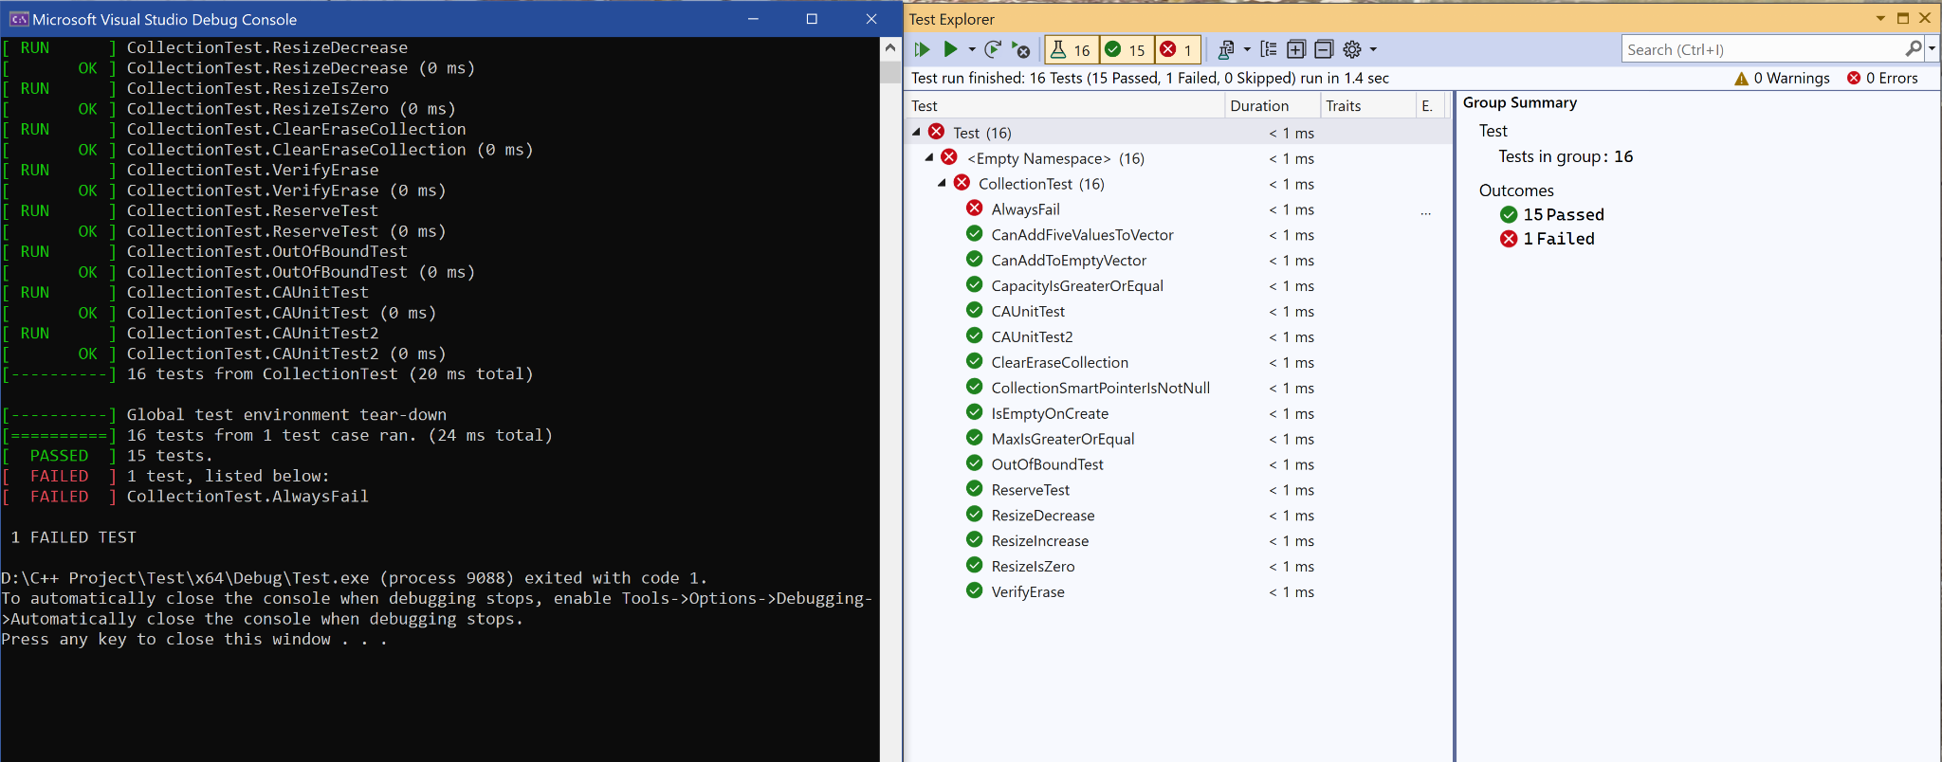
Unit Testing
The primary purpose of unit testing is to test each unit or module of the product at an early stage of development in order to prevent problems from propagating to the next level.

Slide 9
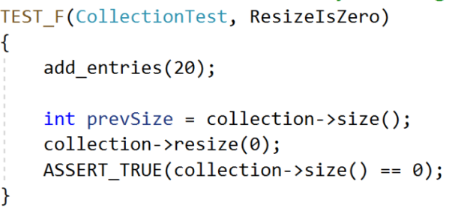
ResizeIsZero
Resizing should decrease the collection to zero.

Slide 10
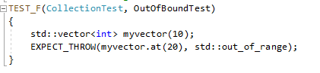
OutOfBoundTest
verifies the std::out_of_range exception is thrown when calling at() with an index out of bounds

Slide 11
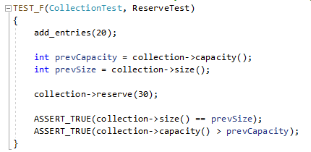
ReserveTest
verifies that reserve increases the capacity but not the size of the collection

Slide 12

AUTOMATION SUMMARY

Slide 13
TOOLS
A DevSecOps pipeline, which is a CICD pipeline with integrated security practices and tooling, extends the software development lifecycle with practices and services such as scanning, threat intelligence, policy enforcement, static analysis, and compliance validation (SDLC).
Tools For Automation
Astrée - is a static code analyzer that proves the absence of run­time errors and invalid con­current behavior in safety-critical software written or gen­er­ated in C or C++.
Parasoft C/C++test - is an integrated set of tools for testing C and C++ source code that software developers use to analyze, test, find defects, and measure the quality and security of their applications.
Cppcheck - is a static analysis tool for C/C++ code. It provides unique code analysis to detect bugs and focuses on detecting undefined behaviour and dangerous coding constructs. The goal is to have very few false positives.

Slide 14
RISKS AND BENEFITS
Risks of Insecure Software - An insecure application lets hackers in. They can take direct control of a device or provide an access path to another device. This can result in:
Denial of service to a single user.
Compromised secrets.
Loss of service.
Damage to the systems of thousands of users.
Loss of life.
Adopting secure coding methods is critical since it eliminates commonly exploited software vulnerabilities and avoids intrusions. Furthermore, optimizing for security from the beginning helps decrease long-term expenses that may develop if an exploit leads in the release of critical user information.

Slide 15
RECOMMENDATIONS
Gaps
Being unprepared to deal with cyber-attacks.
Address any gaps as soon as possible.
Mitigate gaps
Different cyber-threats
Recommendations
Follow the 10 principles of secure coding practices
Implement the Defense in Depth model
Implement the Triple-A security
Test software continuously

Slide 16
CONCLUSIONS
In conclusion, because a malware attack can do severe damage to any piece of software while jeopardizing integrity, authentication, and availability, software security is vital. Damage can be avoided if programmers consider this throughout the development stage rather than subsequently. We should implement the 10 principles of secure coding practices. Implement the Defense in Depth model, encryption policy, and triple-A policy. Regular secure code reviews, together with automated tools that check your code for certain vulnerabilities, can assist prevent such attacks.

Slide 17
REFERENCES
SEI CERT C++ Coding Standard - SEI CERT C++ Coding Standard -
Confluence. (n.d.). Wiki.sei.cmu.edu.
https://wiki.sei.cmu.edu/confluence/pages/viewpage.action?
pageId=88046682
Top 10 Secure Coding Practices - CERT Secure Coding - Confluence. (2018).
Cmu.edu.
https://wiki.sei.cmu.edu/confluence/display/seccode/Top+10+Secure+Coding+Practices
Techopedia. (2021, June 8). What Is Automation? - Definition from
Techopedia. Techopedia.com.
https://www.techopedia.com/definition/32099/automation

